Slide 1
Introduction to NumPy and Pandas
Jasyot Gaur

Slide 2
Surprise!
Write a function that will take input from user. Once done, it will decide if the number is even or odd.
Let’s move one level up!
Now instead of just one number, create a list of number by taking user input. Example, if user enters 8 then the list of numbers will be [0,1,2,3….8].
Check each number and return a list of even numbers!

Slide 3
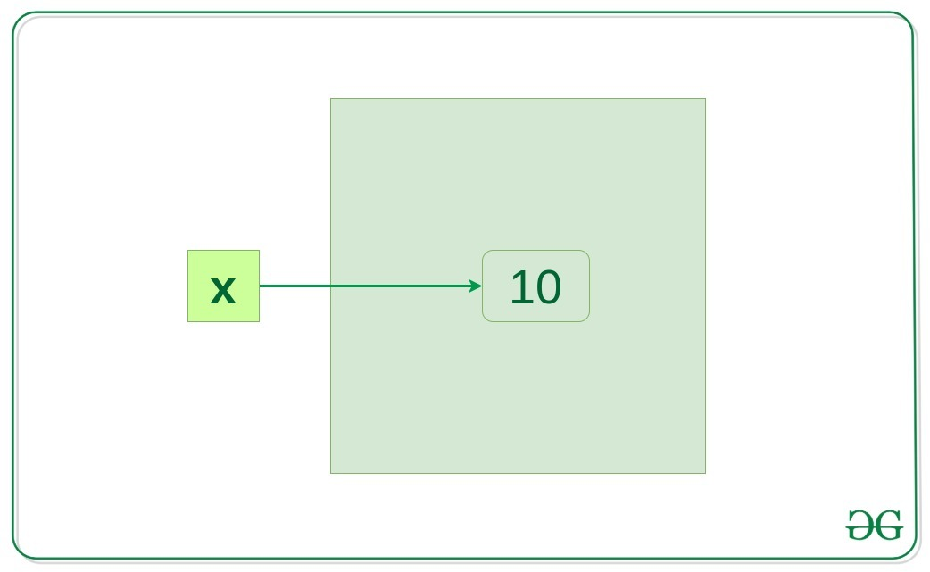
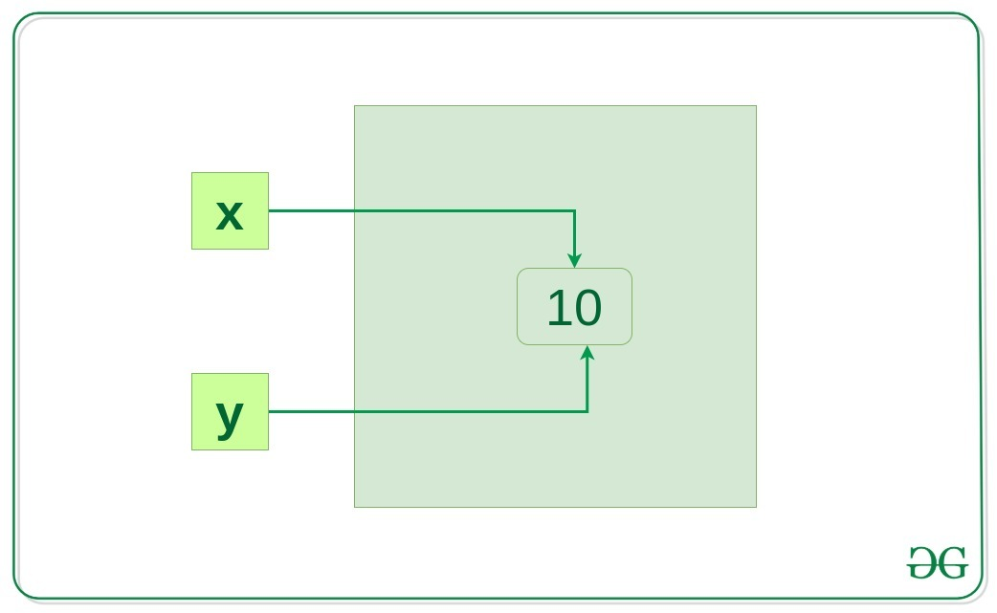
Name Space and Heap Space in Python
X and Y will point to same object to save memory.
Garbage collection is a process in which the interpreter frees up the memory when not in use to make it available for other objects.

Slide 4



Modules and Package in Python
__init__.py
Package
Library
Module
Notes:
Lib is a collection of modules and packages but tailored to a specific requirement.

Slide 5
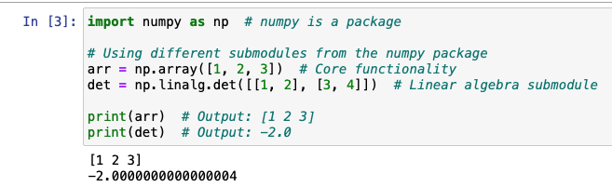
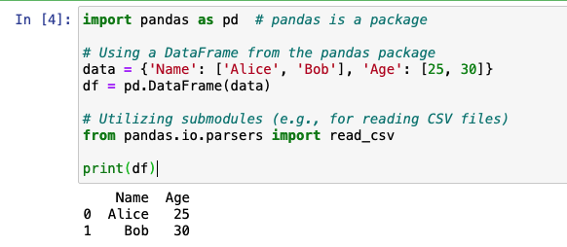
Modules and Package in Python

Slide 6
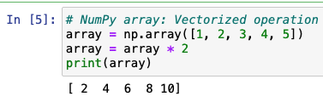
NumPy
NumPy (Numerical Python)
Used to store data in its own data structure called array.
Works only for homogeneous data unlike list
Then why don’t we just use List?
Notes:
Numpy is faster than list because it sits close to hardware as its implemented in C.
Numpy array consume less memory than python list as all elements are directly stored in the memory blocks unlike list which references the objects that lead to extra memory space.
Numpy supports vectorized operations that is you can apply operations on the entire array at once.

Slide 7
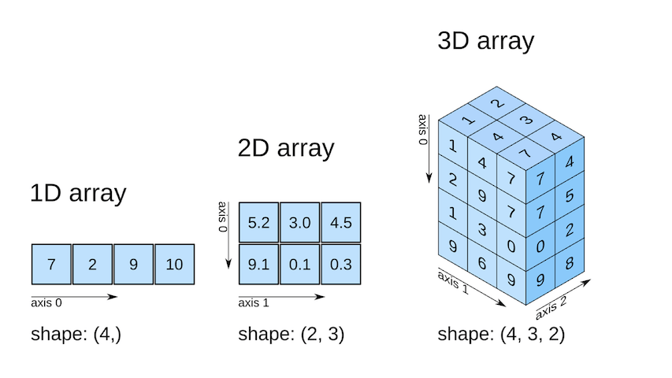
What is an array?
NumPy data structure.
N – dimension.
Axis 0: Rows (Vertically Down)
Axis1: Colls (Horizontal)

Slide 8
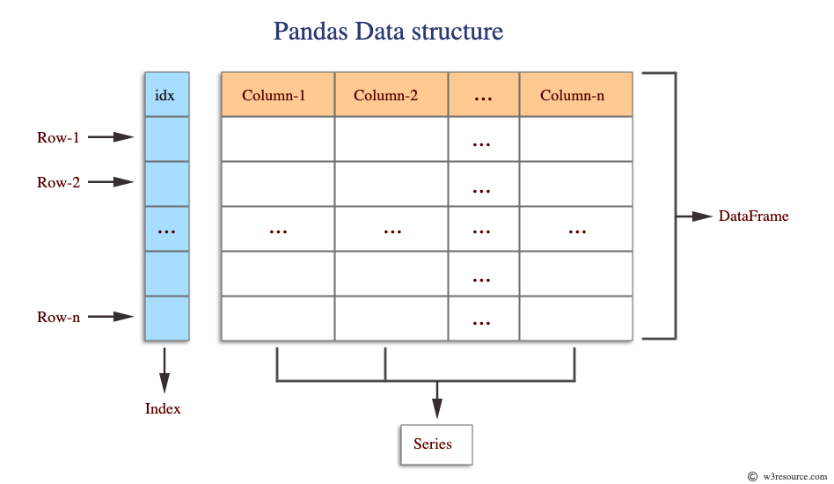
Pandas
Used to run analysis on bulky dataset.
Two data types: “Series” and “DataFrame”.
Series are 1-D and can store any data type (index optional)

Slide 9
Open New Notebook!

